Slide 1


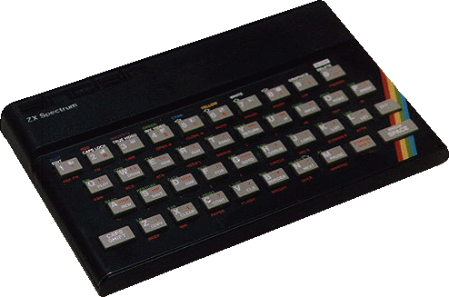
AC22005
Section 2 - Lecture 1
Advanced Architectures - Introduction

Slide 2

Thought for the Day

Slide 3

Graph of the Day

Slide 4
AC22005 Syllabus
C# programming
  Lectures done – labs still to come
Advanced Architectures
  3 weeks - starts now
Operating Systems with John Arnott
  6 weeks - to follow

Slide 5
Syllabus - Dr. Murray
MEMORY
  introduction, multi-level memory, caching, virtual memory, memory management
PROCESSOR
  architecture, instruction pipelines, instruction sets, green issues
I/O
  I/O techniques, workstation architecture

Slide 6
Introduction
In the beginning …

Slide 7
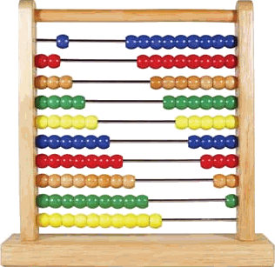
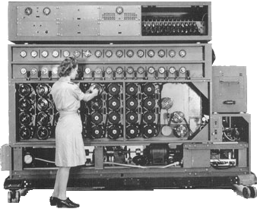
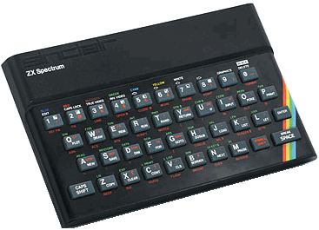

Overview
Mechanical computers
Early electronic computers
Basic microcomputers
Modern microcomputers
AC21009
AC22005

Slide 8
The Philosophy - part 1
  We can make simple binary gate structures that do all the functions needed for computation
  We can combine all of these into a small number of electronic devices
  We design the electronics to read a pre-programmed series of instructions, so that we can create a free-running sequence

Slide 9
The Philosophy - part 2
  Over time, these devices have become so complex and fast that we can’t hope to understand them at the binary level
  We write programs to translate higher-level language scripts into binary, so the low-level electronics can still function
  We are now so good at this, that even programmers don’t need to think in binary !
  Supporting functionality moved into the OS

Slide 10
A Simple Computer
We have seen (in AC21009) that a basic microcomputer consists of a CPU, memory and I/O, all connected via address and data buses.
These are embodied in a “simple microcomputer”.

Slide 11

A Simple Computer
Any Electronic
DATA BUS
Micro-
processor
Memory
Input/
Output
ADDRESS BUS
CLOCK (and other Control Bus signals)

Slide 12
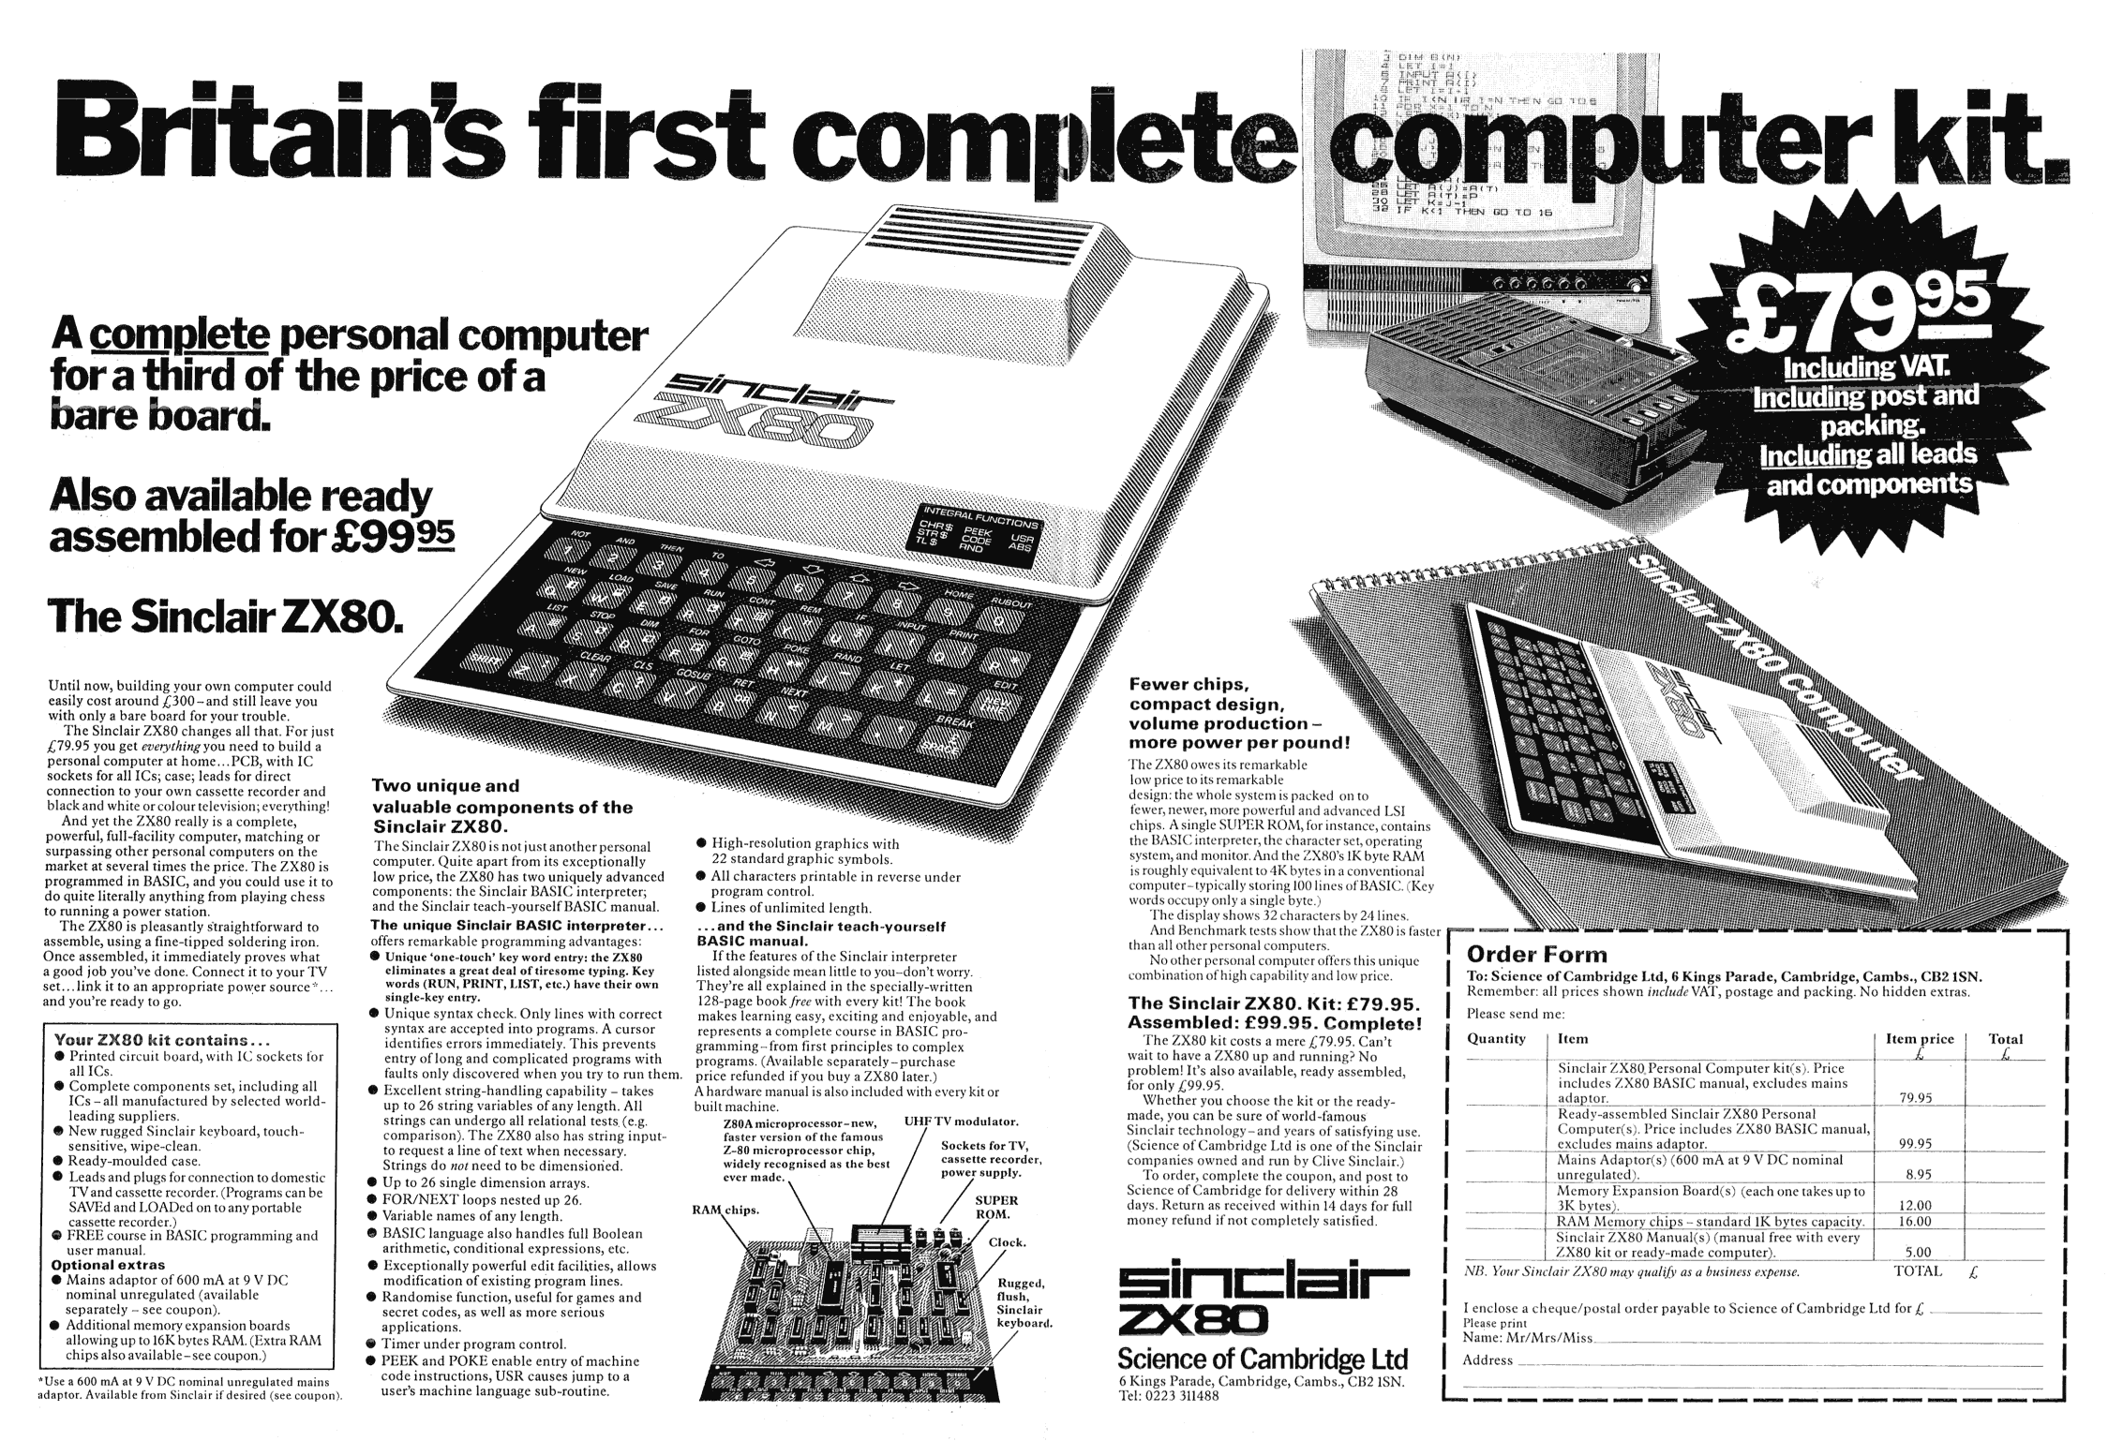

Slide 13
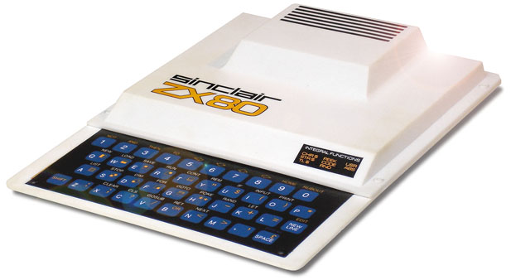
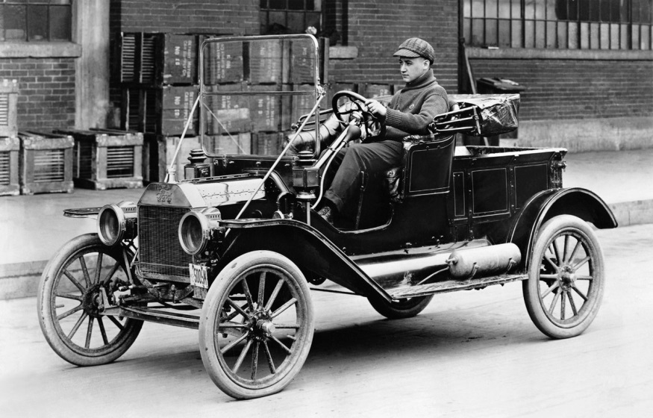
If computers were cars ...
  In layout, similar to the way they are today
  Transitioning from specialist gadget to mass-produced mass-market appeal
  Few features – we want deluxe!
  Slow – we want speed!

Slide 14
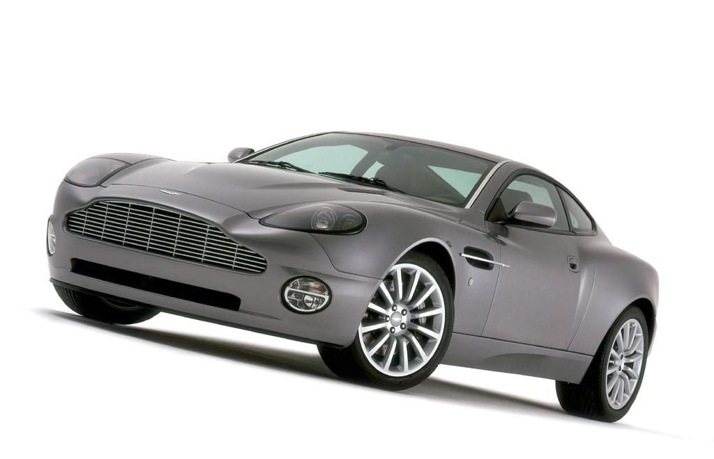
The mission of AC22005

Slide 15
Increase the POWER!
The processor constantly operates a fetch-execute cycle, fetching instructions and data from memory and executing them in an endless stream.
The power of a computer is related to how quickly it can process instructions and data.
IT’S ALL ABOUT SPEED!

Slide 16
Fetch-execute overview
FROM MAIN MEMORY
Instruction (binary number)
Operand (binary number)
Output (binary number)
BACK TO MAIN MEMORY
CPU

Slide 17
Baby Operation
CI
STORE
0000 0000 0000 0000 0000 0000 0000 0000
Increment
32 x 32 bits
32 bits
Increment CI
32 bits
32 bits
32 bits
CI “points to”
the store
32 bits
32 bits
CI
32 bits
0000 0000 0000 0000 0000 0000 0000 0001
32 bits
32 bits
32 bits
32 bits
32 bits
Fetch
32 bits
Instruction Fetch
32 bits
32 bits
32 bits
32 bits
32 bits
32 bits
32 bits
PI
1110 0000 0000 0010 0000 0000 0000 0000
Decode
Decode
Operand
11100
010
Opcode
( = LDN )
Operand “points to” the store
PROCESSOR
Execution
Operand Fetch
Execute

Slide 18
Speeding things up
To make our computer go faster, conceptually we can do several things:
  make the clock tick faster
  improve the structure of the processor
  identify the slow parts of the process … and do less of them
  add parallelism - attempt to do several things at the same time
… and we also get some implicit savings - unexpected extra benefits we didn’t plan for!

Slide 19
At the same time …
As well as making the computer faster, there are some other background factors:
  want to be able to run multiple programs at the same time
  graphical output becoming more sophisticated *
  hard disks becoming available *
  networks becoming available *
  * all of these mean a lot more I/O will be required

Slide 20
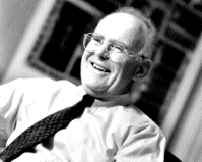
Speeding things up
In 1965, Intel co-founder Gordon Moore said that a silicon chip's number of transistors (and thus its processing power) would double every 18 months.
“Moore’s Law” (in this and other forms) has proven to be remarkably accurate … but this is not enough for power-hungry applications!

Slide 21
So what can we do … ?
We can improve processor performance by:
  adding new instructions and more addressing modes
  putting some operands together with the opcode, so that a separate operand fetch cycle is not needed (the Manchester Baby actually did this)
  pipelining instructions (by processing several instructions at the same time)

Slide 22
So what can we do … ?
We can improve processor performance by:
  using multiple pipelines within one CPU - this is known as super-scalar architecture
  using multiple CPUs
  … and cranking up the clock speed

Slide 23
So what can we do … ?
We can improve memory performance by:
  minimising memory accesses - during an instruction cycle, the processor spends a lot of time waiting on data coming from main memory, so we want to reduce waiting times … we do this by adding a small cache memory to the processor
  … and cranking up the clock speed
  … and remember that the memory will be a lot larger (to hold the multiple processes we are running) but size alone has no effect (+ve or -ve) on memory access speed

Slide 24
So what can we do … ?
We can improve I/O performance by:
  moving faster I/O devices onto faster system buses (so that slower devices don’t slow down the whole computer)
  adopting new and improved I/O techniques (both hardware and software)

Slide 25
What’s the catch?
All of these procedures require a more complex structure for the hardware (and probably for the software too).
They also create their own problems which must be solved to allow successful implementation.
However, if we are prepared to pay the cost of this complexity, then we get the improved performance that we desire.

Slide 26
So ...
Three main points to remember:
  Moore’s Law – performance doubles every 18 months*
  We always want more speed than 1) gives
  We will accept greater complexity (and cost) if that delivers 2)
* number of transistors grows by about 1.6 times / year (proportional to square of linear dimension), speed increases linearly with decreasing size

Slide 27
Memory Re-structuring
Complexity is good!

Slide 28
Memory structure 1
Ideally, we want the processor to be able to access a very large, very fast (register-like) memory.
Even if possible, this would be very expensive, so we must use a separate main memory …
but …main memory accesses take many clock cycles …
so … can we have a main memory that responds with the speed of registers?
A cache tries to do this.

Slide 29
Memory structure 2
Ideally, we want the main memory to be as large as possible.
However, this would also be very expensive, so we must use separate hard disk storage as “virtual memory”.
but …hard disk accesses are very slow …
so … can we have virtual memory that responds with the speed of main memory?
Memory management tries to do this.

Slide 30
Multi-level memory
For practical and economic reasons, today’s PCs have a multi-level memory structure:
CPU registers
L1 Cache
L2 Cache
Increasing size
Increasing speed
Main memory
“Virtual” memory
Hard disk storage
Backup storage

Slide 31
The End is Nigh!
We know that:
  transistor size can’t be reduced forever - Moore’s Law will break down soon
  performance enhancement through some processor enhancements has already gone as far as it can
  increasing interest in green issues
  we need to look ahead to the next processor technology

Slide 32
Summary
IT’S ALL ABOUT SPEED!
We have seen:
  starting point is the basic microcomputer - revise your notes from AC21009!!
  better speed / performance is the new goal
  we will accept increased hardware complexity if it offers better performance
Next meetings:
  Tomorrow at 1100 - C# practical
  Thursday at 1300 - all about caches

